Slide 1
PARIS 2024
OLYMPICS
POWER BI DASHBOARD

Slide 2


Introduction
1
The Paris 2024 Olympics, held from July 26 to August 11, 2024, brought together athletes from around the world to compete in 32 sports across numerous events. Marking the return of the Summer Olympics to Paris after 100 years, the games showcased exceptional talent, diversity, and unity, with iconic landmarks serving as stunning backdrops. This dashboard provides a comprehensive summary of key highlights, performance statistics, and memorable moments from this historic global event.

Slide 3
Purpose of the Analysis
2
The primary purpose of this analysis is to provide a comprehensive and data-driven understanding of the Paris 2024 Olympics. By leveraging interactive dashboards, the analysis aims to highlight key insights about the participating athletes, countries, and historical trends.
This project goes beyond showcasing the scale and diversity of the event by delivering actionable insights tailored to stakeholders, such as event organizers, media professionals, and sports teams. These insights are designed to enable data-driven decision-making, optimize resource allocation, and develop strategic approaches to enhance performance, engagement, and operational efficiency during the games.

Slide 4
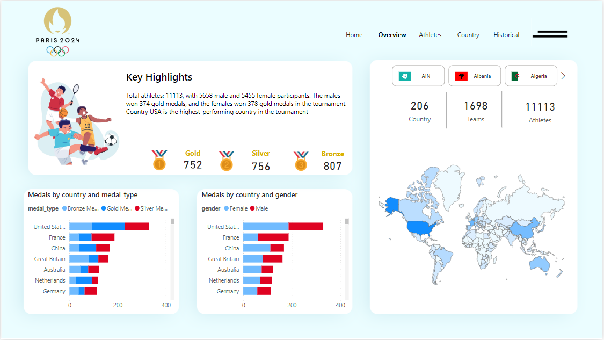
Dashboard Overview
3

Slide 5
Insights from the Overview Dashboard
4
Key Highlights
Medal Performance by Gender: Males secured 374 gold medals, while females won 378 gold medals, reflecting a highly competitive tournament.
Top Performing Country: The USA emerged as the highest-performing country in the tournament, leading in overall medal count.
KPI Summary
Total Countries: 206
Total Teams: 1,698
Total Athletes: 11,113
Medal Distribution Insights
Medal Distribution by Country and Gender: Analyzed using a bar chart, highlighting the top-performing countries by gender.
Medal Distribution by Country and Type: Visualized through a breakdown of gold, silver, and bronze medals, providing insights into the medal performance across the Games.

Slide 6

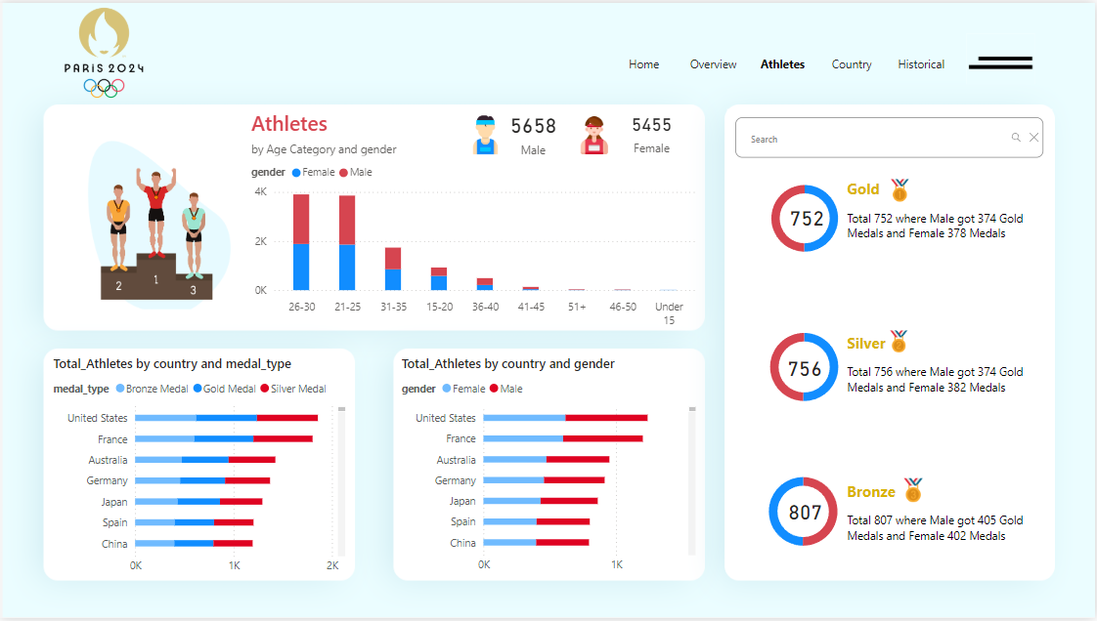
Athlete Overview
5

Slide 7
Insights from the Athlete Dashboard
6
Key Highlights
Total Athletes by Gender: The tournament featured 5,658 male athletes and 5,455 female athletes, showcasing near-equal participation across genders.
Age Categories of Athletes: Athletes were analyzed across different age groups, offering insights into the distribution of younger, prime-age, and older participants. This analysis reveals the age demographics of the Games, helping to identify trends in participation and the potential impact of age on performance across various sports.
Gender-Based Analysis: Visualizations further highlight how male and female athletes performed across different medal types, enabling a deeper understanding of gender-specific trends.
Athletes by Country and Medal Type: This analysis highlights the distribution of athletes by country and their medal types, showcasing nations that excel in specific categories. It provides a clear view of each country's contribution to the overall medal count, offering valuable insights into their competitive strengths.
Summary
The Athlete Dashboard provides a focused view of individual performances, gender representation, and medal achievements, offering valuable insights into the contributions of athletes to the Paris 2024 Olympics. It enhances understanding of participation and performance dynamics.

Slide 8
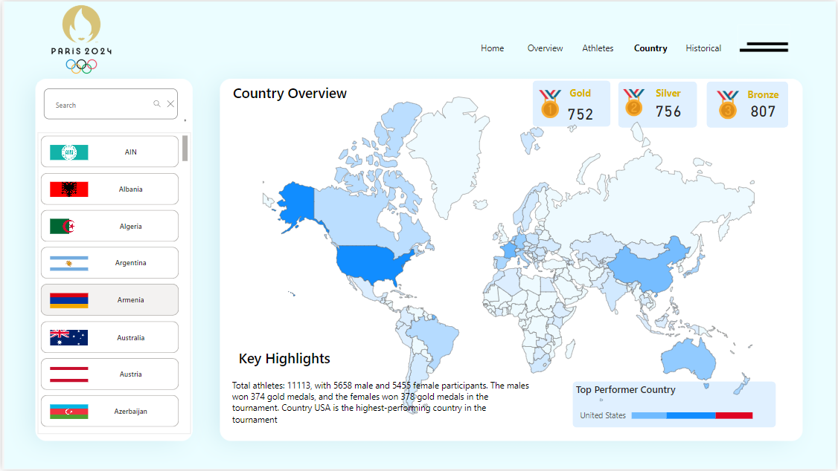
Country Overview
7

Slide 9
8
Insights from the Country Dashboard
Interactive Features
Interactive Medal Map: The map offers an engaging way to explore medal distribution across countries. By hovering over specific countries, users can quickly view the total number of medals won by each nation, making it easier to understand global performance at a glance.
Search Functionality: A search bar allows users to directly find a country, highlighting its exact location on the map. This feature enhances navigation and ensures that users can quickly access specific country data without unnecessary scrolling or searching.
Country Filter with Flags: The country filter, featuring dynamic flags, enables users to select a nation and update the dashboard accordingly. This visually appealing filter enhances the user experience, enabling quick access to country-specific insights and seamless data exploration.
Medal Distribution by Type: Located at the top-right panel, this section provides a detailed breakdown of medals (gold, silver, and bronze) for the selected country. This feature helps users evaluate which medal types a country excels in, offering a deeper understanding of their overall performance and strengths in specific medal categories.
Key Benefits and Insights
This dashboard significantly streamlines the process of analyzing and exploring medal data. With its easy-to-use features like the interactive map, search bar, and country filter, users can quickly focus on individual countries and their performance metrics. The detailed medal distribution by type further enables stakeholders to analyze trends and identify key areas of strength, making the dashboard a valuable tool for in-depth performance analysis across nations.

Slide 10
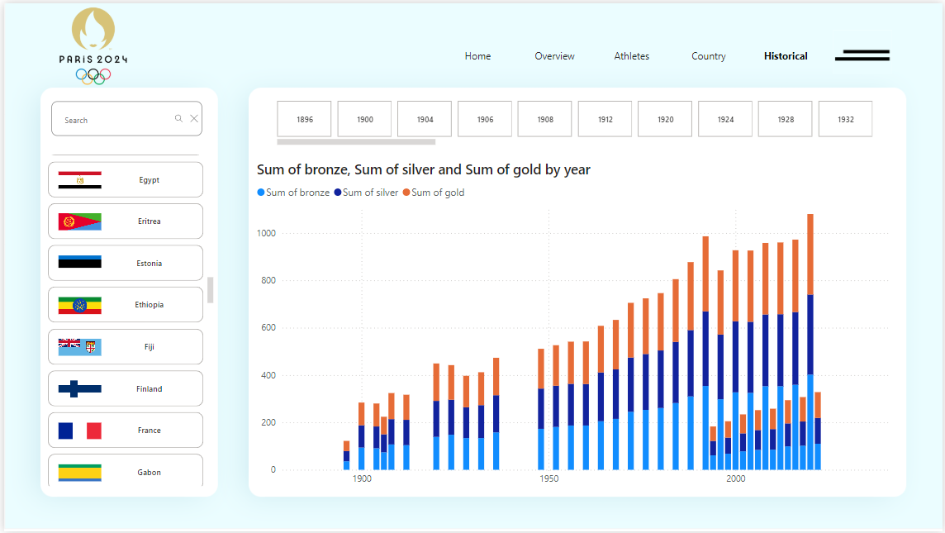
Historical Overview
9

Slide 11
Insights from the Historical Dashboard
This section allows users to filter Olympic data by specific years, providing detailed insights into each country's performance over time. By examining the distribution of medals won each year, stakeholders can track the trends and fluctuations in performance, identifying key periods of improvement or decline for individual countries. This feature is essential for understanding long-term performance trends and can guide strategic decisions for future Olympic planning.
10
Interactive Features
Historical Performance by Year: This section allows users to filter Olympic data by specific years, providing detailed insights into each country's performance over time. By examining the distribution of medals won each year, stakeholders can track the trends and fluctuations in performance, identifying key periods of improvement or decline for individual countries. This feature is essential for understanding long-term performance trends and can guide strategic decisions for future Olympic planning.
Medal Distribution by Type: Each medal type (gold, silver, and bronze) is color-coded, making it easy for users to distinguish the number of medals a country has won in a particular year. By simply hovering over the chart's respective color, users can instantly identify how many gold, silver, or bronze medals a country has earned each year. This user-friendly allows for quick and clear insights into medal distribution, helping to evaluate a country's strengths in different categories over time.
Search Functionality for Specific Countries: A convenient search bar enables users to easily find a specific country and view its historical performance data. This eliminates the need for manual searching and enhances the user experience by providing quick access to the relevant data.
Key Benefits and Insights
This dashboard streamlines the process of analyzing historical Olympic performance, providing stakeholders with an easy-to-use tool for tracking country-specific trends over the years. The combination of year-wise filtering, medal distribution breakdowns, search functionality, and country flag filters makes it simple to extract valuable insights on a country's performance evolution. This clarity in data presentation enables more informed decision-making and helps in identifying key patterns, strengths, and areas for future improvement.

Slide 12


Findings
11
01
Top Performer
The United States stands as the highest-performing country in the Olympics, leading across multiple medal categories.
02
Global Participation
A total of 206 countries participated this year, with 1698 teams competing in various events.
Gender performance
Male athletes secured 374 gold medals, while female athletes won 378 gold medals, showcasing a strong performance from both genders.
03
Athlete Stats
The total number of athletes was 11,113, with a near-equal distribution of 5,658 male athletes and 5,455 female athletes.
04

Slide 13
Conclusion
12
Key Insights:
The United States leads as the top-performing country across medal categories. This year, 206 countries participated with 1,698 teams and 11,113 athletes, highlighting the global scale of the Olympics. Female athletes slightly outperformed male athletes in gold medal wins, showing progress in gender balance in sports achievements.
Challenges:
Performance gaps between countries highlight the need for better support and resources for underrepresented nations. Ensuring fair resource allocation for male and female athletes remains a challenge. Inconsistent medal trends in historical data require deeper analysis to address performance gaps effectively.
Recommendations:
Countries should invest in athlete development through better training and resources, especially in underperforming regions. Encouraging youth sports participation and business funding can provide athletes with the support needed to excel.

Slide 14
THANK YOU

